Slide 1
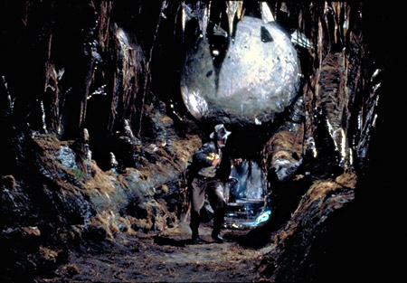
Update on the NIST
Post-Quantum Cryptography Project
http://indianajones.wikia.com/wiki/Raiders_of_the_Lost_Ark
Dustin Moody
National Institute of Standards and Technology (NIST)

Slide 2
Classical vs Quantum Computers
The security of crypto relies on intractability of certain problems to modern computers
  Example: RSA and factoring
Quantum computers
  Exploit quantum mechanics to process information
  Use quantum bits = “qubits” instead of 0’s and 1’s
  Superposition – ability of quantum system to be in multiples states at the same time
  Potential to vastly increase computational power beyond classical computing limit
Notes:
Quantum mechanics = behavior of small objects: atoms, electrons, photons
Superposition – allows for doing multiple computations at same time
Difficulties
When a measurement is made on quantum system, superposition collapses
Quantum states are very fragile and must be extremely well isolated
Intersection of many developing fields: superconductors, nanotechnology, quantum electronics, etc…

Slide 3
The Sky is Falling?
If a large-scale quantum computer could be built then….
Public key crypto:
  RSA
  ECDSA (and Elliptic Curve Cryptography)
  DSA (and Finite Field Cryptography)
  Diffie-Hellman key exchange
Symmetric key crypto:
  AES
  Triple DES
Hash functions:
  SHA-2 and SHA-3

Slide 4
The Sky is Falling?
If a large-scale quantum computer could be built then….
Public key crypto:
  RSA
  ECDSA (and Elliptic Curve Cryptography)
  DSA (and Finite Field Cryptography)
  Diffie-Hellman key exchange
Symmetric key crypto:
  AES
  Triple DES
Hash functions:
  SHA-2 and SHA-3

Slide 5
The Sky is Falling?
If a large-scale quantum computer could be built then….
Public key crypto:
  RSA
  ECDSA (and Elliptic Curve Cryptography)
  DSA (and Finite Field Cryptography)
  Diffie-Hellman key exchange
Symmetric key crypto:
  AES
  Triple DES
Hash functions:
  SHA-2 and SHA-3
Vulnerable NIST standards
  FIPS 186, Digital Signature Standard
    Digital Signatures: RSA, DSA, ECDSA
  SP 800-56A/B, Recommendation for Pair-Wise Key Establishment Schemes
    Discrete Logs: Diffie-Hellman, MQV
    Factorization based: RSA key transport

Slide 6
The Sky is Falling?
If a large-scale quantum computer could be built then….
Public key crypto:
  RSA
  ECDSA (and Elliptic Curve Cryptography)
  DSA (and Finite Field Cryptography)
  Diffie-Hellman key exchange
Symmetric key crypto:
  AES Need longer keys
  Triple DES Need longer keys
Hash functions:
  SHA-2 and SHA-3 Use longer output
Vulnerable NIST standards
  FIPS 186, Digital Signature Standard
    Digital Signatures: RSA, DSA, ECDSA
  SP 800-56A/B, Recommendation for Pair-Wise Key Establishment Schemes
    Discrete Logs: Diffie-Hellman, MQV
    Factorization based: RSA key transport

Slide 7
How soon do we need to worry?
Potentially as early as 15 years to break RSA-2048
  15 years, $1 billion USD, small nuclear power plant (Mariantoni, 2014)
  50% chance (Michele Mosca)
PQC needs time to be ready for applications
  Confidence – cryptanalysis
  Implementations
  Usability and interoperability (IKE, TLS, etc. … use public key crypto)
  Standardization
Transition has to be soon enough that any data compromised by quantum computers is no longer sensitive when compromise occurs

Slide 8

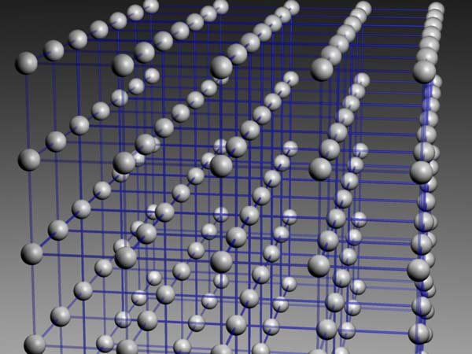
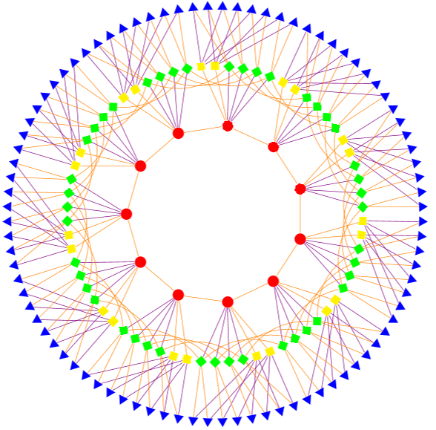
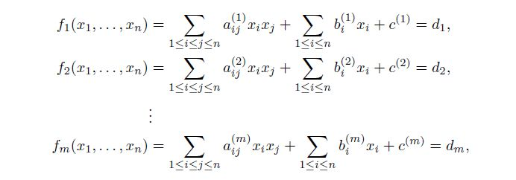
Possible Replacements
Lattice-based
Code-based
Multivariate
Others
  Hash-based signatures
  Isogeny-based signatures
  Etc….
All have their pros and cons
Notes:
Cryptosystems which run on classical computers, and are considered to be resistant to quantum attacks

Slide 9
Initial Observations
For most of the potential PQC replacements, the times needed for encryption, decryption, signing, verification are acceptable
Some key sizes are significantly increased
  For most protocols, if the public keys do not need to be exchanged, it may not be a problem
Some ciphertext and signature sizes are not quite plausible
Key pair generation time for the encryption schemes is not bad at all
No easy “drop-in” replacements
Would be nice to have more benchmarks

Slide 10
Gathering Steam
PQCrypto Workshop series
ETSI workshops
European PQCrypto project, Quantum flagship
Japan’s SAFECRYPTO project
IETF hash-based signatures
ISO/IEC JTC 1 SC 27 – study period on PQC
Fall 2015: NSA announced it would be transitioning in the “not too distant” future https://www.iad.gov/iad/programs/iad-initiatives/cnsa-suite.cfm

Slide 11
The NIST PQC Project http://www.nist.gov/pqcrypto
Biweekly seminars since 2012
Guest researchers and invited speakers
Research: publications and presentations
  PQCrypto, AWACS, ICICS, CRYPTO, Qcrypt, Eurocrypt, ETSI Quantum-safe workshops, etc.
Out Reach
  PKI community, Automotive industry talks
2015: NIST PQC workshop http://www.nist.gov/itl/csd/ct/post-quantum-crypto-workshop-2015.cfm
Feb 2016: NIST report on PQC- http://csrc.nist.gov/publications/drafts/nistir-8105/nistir_8105_draft.pdf
Feb 2016: NIST announced preliminary standardization plan at PQCrypto https://pqcrypto2016.jp/data/pqc2016_nist_announcement.pdf

Slide 12
Collaboration
IETF – CFRG
ISO/IEC JTC 1 SC 27
ETSI
  Workshops, white papers
Universities
  University of Maryland (QuiCS)
  University of Waterloo (Cryptoworks 21)
Guest Researchers and Speaker
  Lyubachevsky, Ding, Takagi, Petzoldt, Faugere, Gligoroski, Perret, etc…

Slide 13
Timeline
June 2016 – Draft Call For Proposals released for public comment
Fall 2016 – formal Call For Proposals finalized
Nov 2017 – Deadline for submissions
3-5 years – Analysis phase
  NIST will report its findings
2 years later - Draft standards ready (2023-2025)
Workshops
  Early 2018 – submitter’s presentations
  One or two during the analysis phase
Notes:
Tentative – depends on type, quality, and quantity of submissions

Slide 14
Call for Proposals
NIST is calling for quantum-resistant cryptographic algorithms for new public-key crypto standards
  Digital signatures
  Encryption/key-establishment
We see our role as managing a process of achieving community consensus in a transparent and timely manner
We do not expect to “pick a winner”
  Ideally, several algorithms will emerge as ‘good choices’
We may pick one (or more) for standardization
  Only algorithms publicly submitted considered
Notes:
We hope to focus the attention of cryptographers, academia, industry, and government on post-quantum cryptography
Our goal is to pick a candidate that is "well rounded" in the sense that it meets everyone's minimum requirements
We obviously will choose what goes into a NIST pub

Slide 15
Differences with AES/SHA-3 competitions
Post-quantum cryptography is more complicated than AES or SHA-3
  No silver bullet - each candidate has some disadvantage
  Not enough research on quantum algorithms to ensure confidence for some schemes
We do not expect to “pick a winner”
  Ideally, several algorithms will emerge as “good choices”
We may narrow our focus at some point
  This does not mean algorithms are “out”
Requirements/timeline could potentially change based on developments in the field
Notes:
We will devote substantial amount of resources, but will be less than for SHA-3

Slide 16
Minimal acceptability requirements
  Publicly disclosed and available with no IPR
    Signed statements, disclose patent info
  Implementable in wide range of platforms
  Provides at least one of: signature, encryption, or key exchange
  Theoretical and empirical evidence providing justification for security claims
  Concrete values for parameters meeting target security levels

Slide 17
Specification
Implementation
  Reference version
  Optimized version
Cryptographic API will be provided
  Can call approved hash functions, block ciphers, modes, etc…
Known Answer tests
Optional – constant time implementation
Notes:
Source code in ANSI C. Optimized version targets Intel x64 processor

Slide 18
Evaluation criteria
To be detailed in the formal Call
  Security
  Cost (computational and memory)
  Algorithm and implementation characteristics
Draft criteria will be open for public comment
We strongly encourage public evaluation and publication of results concerning submissions
NIST will summarize the evaluation results and report publicly
Notes:
Criteria are given in order of importance

Slide 19
Security Analysis
Security definitions
  IND-CCA2 for encryption, EUF-CMA for signatures, CK best for key exchange?
  Used to judge whether an attack is relevant
Quantum/classical algorithm complexity
  Stability of best known attack complexity
  Precise security claim against quantum computation
  Parallelism?
Security proofs (not required but considered as support material)
Quality and quantity of prior cryptanalysis
Notes:
We may ask for a wider range of security levels than we ultimately decide to standardize
Indistinguishability under adaptive chosen ciphertext attack
EUF-CMA: Existential unforgeability under adaptive chosen message attacks
Canetti-Krawczyk

Slide 20
Target Security Levels
 | Classical Security | Quantum Security | Examples
I | 128 bits | 64 bits | AES128 (brute force key search)
II | 128 bits | 80 bits | SHA256/SHA3-256 (collision)
III | 192 bits | 96 bits | AES128 (brute force key search)
IV | 192 bits | 128 bits | SHA256/SHA3-256 (collision)
V | 256 bits | 128 bits | AES128 (brute force key search)
Notes:
In specifying these security strengths, the intent is that parameter sets meeting security strengths 1, 3, and 5 will remain secure as long as brute-force attacks against AES-128, AES-192, and AES-256, respectively, remain infeasible. Likewise, parameter sets meeting security strengths 2 and 4 should remain secure roughly as long as brute-force collision attacks against SHA-256/ SHA3-256 and SHA-384/SHA3-384, respectively, remain infeasible.

Slide 21
Cost
Computational efficiency
  Hardware and software
    Key generation
    Encryption/Decryption
    Signing/Verification
    Key exchange
Memory requirements
  Concrete parameter sets and key sizes for target security levels
  Ciphertext/signature size
May need more than one algorithm for each function to accommodate different application environments

Slide 22
Algorithm and Implementation Characteristics
Ease of implementation
  Tunable parameters
  Implementable on wide variety of platforms and applications
  Parallelizable
  Resistance to side-channel attacks
Ease of use
  How does it fit in existing protocols (such as TLS or IKE)
  Misuse resistance
Simplicity

Slide 23
The Evaluation Process
Initial evaluation phase (12-18 months)
  No tweaks/modifications allowed
  Workshops at beginning and end of initial evaluation phase
Report findings and narrow candidate pool
Second evaluation phase (12-18 months)
  Small modifications allowed
  Workshop towards end of second phase
Report findings and narrow candidates
Select algorithms for standardization or decide more evaluation needed

Slide 24
Call for Feedback
How is the timeline?
  Do we need an ongoing process, or is one time enough?
How to determine if a candidate is mature enough for standardization?
  hash-based signatures for code signing
We are focusing on signatures and encryption/key-establishment. Should we also consider other functionalities?
How can we encourage people to study practical impacts on the existing protocols?
  For example, key sizes may be too big

Slide 25
Conclusion
NIST is calling for quantum-resistant algorithms
  We see our role as managing a process of achieving community consensus in a transparent and timely manner
  Different from (but similar to) AES/SHA-3 competitions
PQC Standardization is going to be a long journey
We don’t have all the answers
Be prepared to transition to new (public-key) algorithms in 10 years
  The transition will not be painless
    NIST will provide transition guideline when PQC standards are developed
  Prepare the application designers
    Focus on crypto-agility

